Slide 1
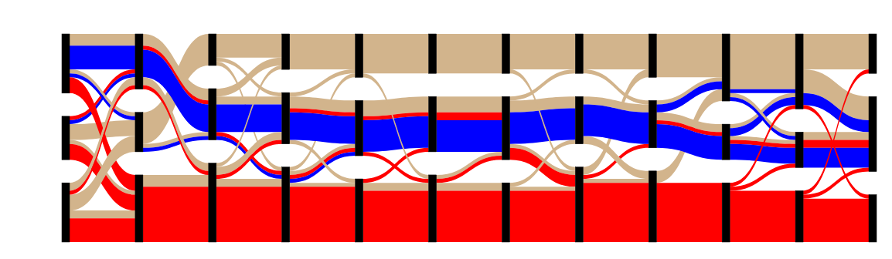
Months
Clusters

Slide 2
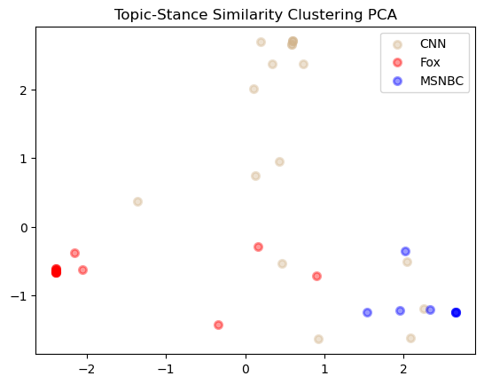
Fareed Zakaria GPS
Fox News Sunday
Your World with Neil Cavuto

